Slide 1
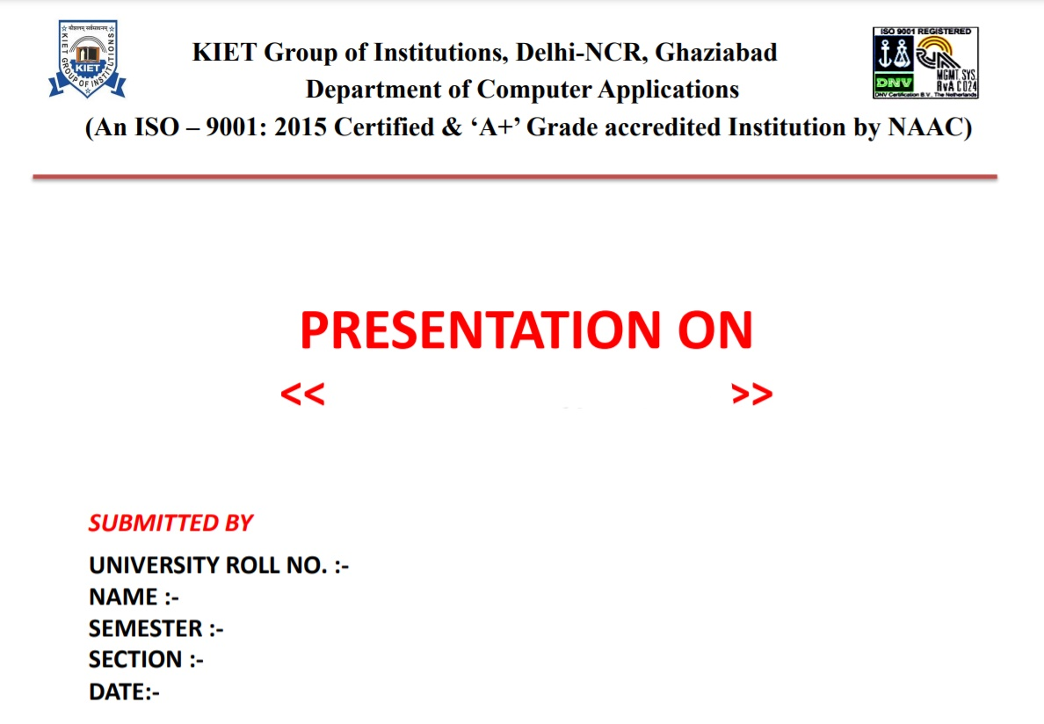
WEB DEVLOPMENT
1900290140007
Anupam Shukla
6 th
A
19/02/2022

Slide 2
Website Testing

Slide 3
Website text
Web page text should be treated like documentation and tested using the techniques we described previously.
Check for …
  correctness of contact information e.g., phone numbers, addresses
  correctness of dates and copyright notices
  title bar text, bookmark text on browser’s favorites
  correctness of the ALT text (i.e., mouse over text)
  layout issues when browser window is resized

Slide 4
Website hyperlinks
Each link should be checked to make sure it jumps to the correct destination or website.
Ensure that hyperlinks are obvious:
  E.g., underlined text, mouse pointer changes
If the link opens an e-mail message, test it
  Send an e-mail and verify that you get a response.
Check for orphan pages that are part of the website but cannot be accesses through a hyperlink.
  Someone forgot to create the link
  Might be intentional … Google will find it, though

Slide 5
Website graphics
Do all graphics load and display properly?
Is a graphic missing or incorrectly named?
Does the website intermix text and graphics?
  Does the text wrap around the graphics?
  What happens when the browser window is re-sized?
Does the page load fast enough?
  Are there too many graphics?
  Did you try to test the website on a dialup connection instead of a high-speed LAN?

Slide 6
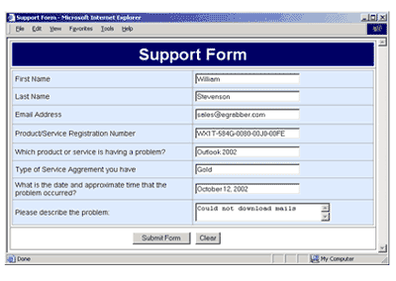
Website forms
Forms are the text boxes, list boxes, and other fields for entering and selecting information on the web page.
Are the form fields positioned properly?
Are the fields the correct size?
Do they accept correct data?
Do they reject bad data?
Are optional fields really optional?
A favorite entry point for buffer overflow attacks (more on this later).

Slide 7
Dynamic content
Dynamic content is graphics and text that changes based on certain conditions.
  E.g., time of day, weather, stock tickers
Client-side programming involve embedding scripting code (e.g., JavaScript) into HTML.
  Less efficient if the computations are expensive
  Code is local, easy to access for testing
Server-side programming is code located on the server.
  More efficient for intensive calculations
  Requires access to the web server to view the code (might be a problem for testing).

Slide 8
Database-driven web pages
Most E-commerce that show catalogs or inventories are database driven.
  E.g., Amazon
Data is pulled from the database, formatted into HTML and sent to the web browser for viewing.A three tier architecture is used:
  Tier 1: web browsers (presentation)
  Tier 2: web page formatter (converts data from Tier 3 to HTML)
  Tier 3: database (queried by Tier 2)

Slide 9
Programmatically- created web pages
HTML or code is generated by a program.
  E.g., a web designer may drag and drop elements in a layout program, press a button, and get an HTML page.
Compilers do this all the time, except they translate high-level language code (Java source code) into low-level code that can be executed natively or on a VM (e.g., byte code).
Testing these systems is like testing a compiler …

Slide 10
Configuration and compatibility testing
Hardware platform
  Mac, PC, PDA, WiFi wristwatch?
Browser software version
  Firefox 1.0, IE 6.0, Pocket IE, Netscape 7.2, Safari 2.0.4
Browser plug-ins
  To play specific types of audio or video files
Browser options
  Security options, ALT text, plug-in, pop ups
Video resolution and color depth
  640x480, 800x600, 1024x768, 1280x1024, 256 colors, 16 colors
Text size
  Small fonts, medium fonts, large fonts
Connection speed
  DSL, modems of varying speed.

Slide 11
Website testing tools
Check out www.netmechanic.com
Website testing is very labor-intensive.
Tools that automatically check websites for:
  Browser compatibility
  Performance problems
  Broken hyperlinks
  HTML standard adherence
  Spelling on text

Slide 12
Web applications
Website - requests are navigational requests.
Web Application - requests can affect the state of the business logic on the server.

Slide 13
Some website tested by me
Nestleprofessional.in
Purina.in
Nestle Milkmaid.in
Resourcehighprotein.in

Slide 14

Figma is the first interface design and prototyping tool based in the browser
It works in web browsers, but there is also a desktop app that let you work off-line.
Figma don’t offer a full off-line experience. Any files you currently have open in the desktop app can be edited while you are offline. When you’re back online the changes you made should sync. However, you won’t be able to import any files if you are not currently online.

Slide 15
Tools
Move and Scale tools. When you open files in the Editor, Figma will select the Move Tool V by default
.
Frame and Slice tools. If you've used design tools before, you'll be familiar with Artboards.
Shape tools.
Pen and Pencil tools
Text tool.
Hand tool.
Comment tool.
Edit Object.

Slide 16
Figma is a digital product design tool that excels in six areas
Accessibility and collaboration
Flexibility to iterate and produce deliverables
Ability to build prototypes and test
Establishing a single source of truth
Smooth handoff to developers
Room for improvement with plugins

Slide 17
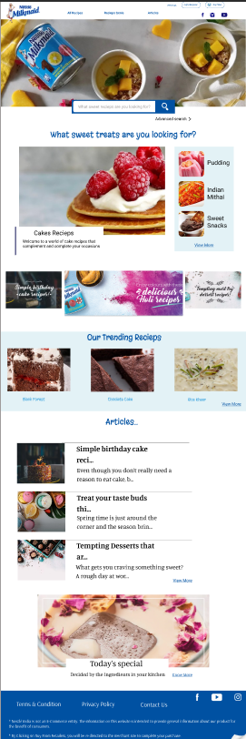
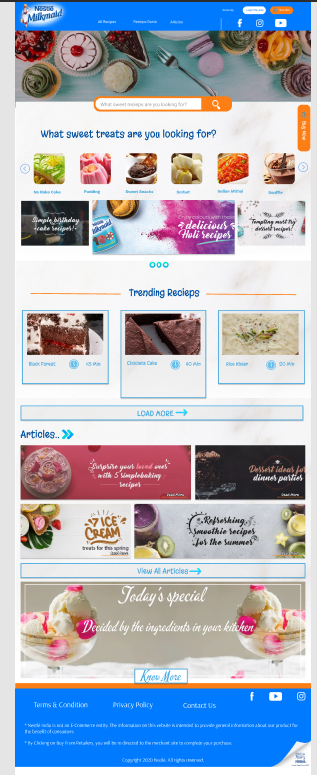

Slide 18
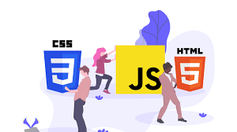
Fundamental of Web Development With
HTML5, CSS3, JavaScript

Slide 19
Importance of Web Development
The Internet is ubiquitous
The Website
Accessible through mobile and desktop
Customers/users need to find you/your business
Builds trust in your organization and improves your reputation
Creates first impression of your business
Create it to suit the needs of your target audience

Slide 20
Front End and Back End Web Development
Front End Web Development
Back End Web Development
Defined component on the page with HTML
Make them look pleasing with CSS
Enable interactivity with JavaScript
Enhance productivity with use of frameworks
Create the page components and content dynamically on the web server
Send the HTML + CSS +JavaScript to web browser ( used by a human user )
Generate pages by programming in java, JavaScript, PHP, Python
Aim to achieve fast response times to end users

Slide 21
HTML, CSS, and JavaScript
HTML
JavaScript
CSS
Hypertext Markup Language
Structure of Page
Interactivity with User
Dynamic Updates in a Web Page
Cascading Style Sheets
Presentation/Styling

Slide 22
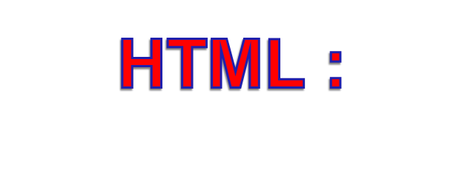
HTML is the lingua franca for publishing hypertext on the World Wide Web
Define tags <html><body> <head>….etc
Allow to embed other scripting languages to manipulate design layout, text and graphics
Platform independent
Common features :
  Tables
  Frame
  Form
  Image map
  Character Set
  Meta tags
  Images, Hyperlink, etc…

Slide 23

Simple mechanism for adding style to web page
Code be embedded into the HTML file
HTML tag:
<style type=“text/css”>CODE</style>
Also be in a separate file FILENAME.css
HTML tag:
<link rel=“stylesheet” href=“scs.css” type=“text/css”>
Style types mainly include:
Font
Color
Spacing
Controls format:
  Font, color, spacing
  Alignment
  User override of styles
  Aural CSS (non sighted user and voice-browser)
  Layers
    Layout
    User Interface

Slide 24
CURRENTLY WORK ON THIS DESIGN :
Nestle Milkmaid

Slide 25


